Slide 1
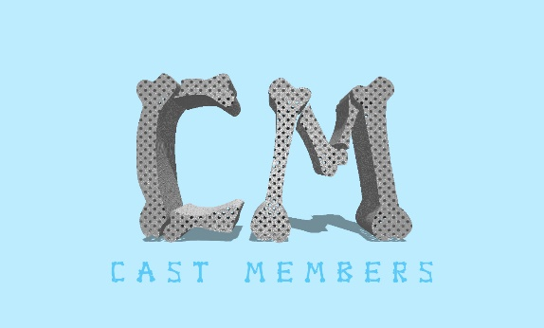




Generates sales revenue.
Option 1: sell casts at €100 a piece
Option 2: sell yearly subscription of €20000. Casts €50 each.
Sales
Representatives
5% commission
Hospitals
Provides 2 options to Hospitals to avail of casts.
Rehabilitation
Centres
Pays Extra for better cast (circa €150)
Physician’s
Offices
Patient
Provide Patient with cast and treatment

Slide 2
